Slide 1
Using Single Sign-On (SSO) with Office Add-ins
Azure AD applications for Office Add-ins and SSO

Slide 2

Azure AD applications for Office Add-ins and SSO-
Use Azure AD applications for Office Add-in SSO
Best Practices & Guidance

Slide 3
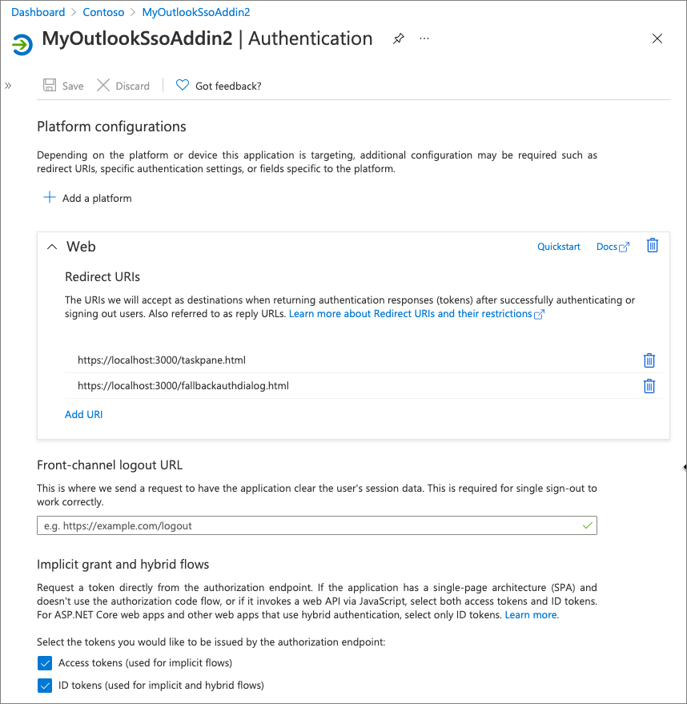
Azure AD applications & Office Add-in SSO
Overview
Every Office Add-in that leverages SSO must have an Azure AD application associated with it
Must only support multitenant application type
Authentication details
Web platform redirect URI’s should include
Web page loaded in the task pane / add-in
Fallback authorization dialog URL
Must support both tokens for implicit grant
Access tokens
ID tokens

Slide 4
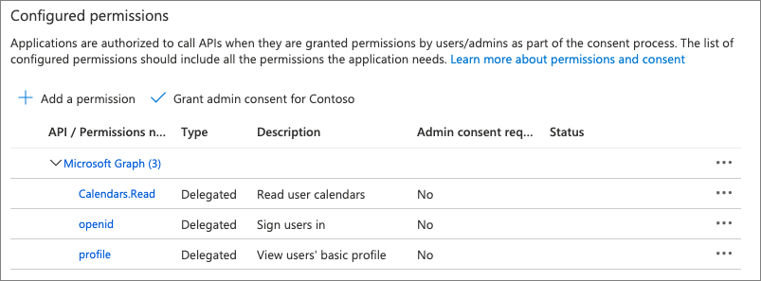
Azure AD applications & Office Add-in SSO
Permissions
Every Office Add-in that leverages SSO must request minimal OpenID permissions
openid
profile
Some libraries used by the add-in require additional properties
MSAL.NET requires office_access
Microsoft Graph permissions
If your Office Add-in also uses Microsoft Graph, you should include the permissions here
Consider consenting to all permissions on behalf of your users

Slide 5
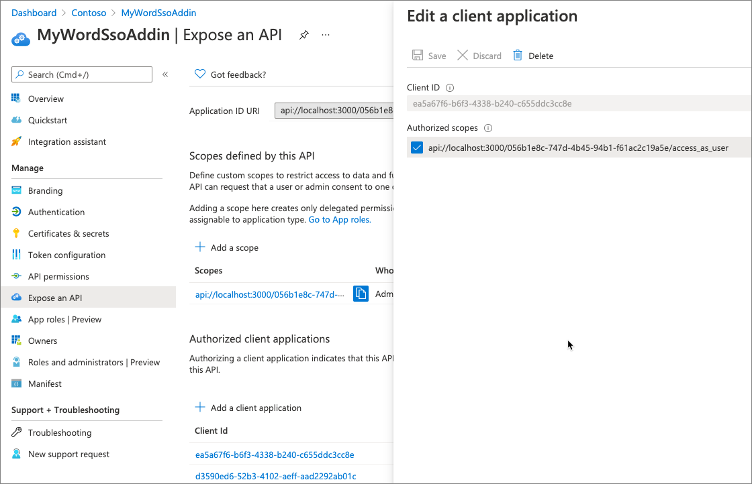
Azure AD applications & Office Add-in SSO
Exposing an API
Application’s ID URI must include the domain where other resources used by the add-in are hosted
Defined by the <Resources> element in the add-in’s manifest.xml file
Define the access_as_user permission so Office clients can pass a token that can be used in the Oauth2 OBO flow
Preauthorize Office clients
Consider authorizing all Office client IDs to the access_as_user permission for the app
Ensure maximum use of your add-in across all Office clients (web, desktop, mobile)

Slide 6
Best practices in Office Add-in SSO development
Use allowConsentPrompt if you only need the user's profile
Implement a fallback authorization method
Implement the 'fail fast' approach to authorization
Pre-authorize all Office clients with your add-in

Slide 7
Demo
Notes:
In this demo, we will create a new React add-in using the Office Yeoman generator and look at the use of the Office UI Fabric
1. Open the Demo/Lab markdown for this section in the module
2. Complete the Provision the Office add-in and Side-load the Office add-in steps
3. Update the code in Office.initialize to update the A1 cell of the worksheet:
await Excel.run(async (context) => {
var sheet = context.workbook.worksheets.getActiveWorksheet();
var range = sheet.getRange("A1:A1");
range.values = [["Hello World"]];
await context.sync()
});
4. Return to code and open src/components/progress.tsx and show how the Spinner component from Office UI Fabric React is used.
5. Run the complete solution located in the Demos/01 Build Add-in using React folder
Stop the server on the previous steps
Clone
Run npm install
Run npm run start
Side-load the add-in (or just refresh the one already running as it uses the same port)

Slide 8

Summary
Use Azure AD applications for Office Add-in SSO
Best Practices & Guidance

Slide 9
Reading further
Office Add-ins documentation
https://docs.microsoft.com/office/dev/add-ins/
Overview of authentication & authorization in Office Add-ins
https://docs.microsoft.com/office/dev/add-ins/develop/overview-authn-authz
Enabling single sign-on for Office Add-ins
https://docs.microsoft.com/office/dev/add-ins/develop/sso-in-office-add-ins
Authorize to Microsoft Graph with SSO
https://docs.microsoft.com/office/dev/add-ins/develop/authorize-to-microsoft-graph

Slide 10
Thank you

